Slide 1
p. 1: Welcome Page
Welcome to the study and thank you for your participation!
This study takes approximately XX minutes to complete. Upon successful completion of the study, you will receive a reward of $X.XX.
Please read the information provided carefully and note that this study contains questions and control mechanisms designed to check your attention. Failure to pass these attention checks will result in immediate termination from the study and you will not receive any payment.
All data collected will remain anonymous and will be used for academic research purposes only.
Continue to task description
Notes:
should take -> takes
Please note that this study includes questions and control mechanisms designed to evaluate your attention. Failure to pass these checks will result in immediate termination of the study. Upon successful completion of the study and passing all attention checks, you will receive a reward of $X.XX.
Könnte man etwas knapper schreiben oder? Und wollen wir nicth zuerst das payment nennen und dann die info mit den checkes?
Bewusst auf eine seite?
Von Steffi:
Takes -> adressiert
Payment und Attention Checks getauscht -> adressiert
Bewusst auf eine Seite -> ich finde es besser auf zwei Seiten, aber wurde damals von euch überstimmt ☺ habs wieder auf zwei gemacht

Slide 2
p. 2: Online Shopping Scenario and Task Description
Online shopping scenario and task description
Imagine you're searching for a new TV on an online shopping site like Amazon or Best Buy. To help you choose the right one, picture yourself reading customer reviews on the online shopping site from people who have already bought a TV.
On each of the following pages, you will be presented with two of such customer reviews side by side. For each pair, choose the customer review that you would find more helpful in making a purchase decision. Then confirm your choice by clicking the 'Confirm selection’ button.
I understood the task description

Slide 3


p. 3: Discrete Choice (I) – Instructional Choice Set
Example
Please read the reviews carefully and choose the review that you would find more helpful in making a purchase decision. To select this review, please click the 'This review is more helpful' button. Then confirm your choice by clicking the 'Confirm selection’ button.
User
User
So far so great!
TV and sound
I bought this for my fiancé so he can have a tv for himself. The set up was always a bit confusing but I got there. And since the set up I had no issues, the sounds is awesome, the picture is great, I’m so far very satisfied and impressed.
When I set up the TV the picture was great. But the sound was a little good until I went to set up and raise the bass and other once after that I went back to the volume and put it on 10 it sound real loud. I like it and its value for the money.
This review is more helpful.
This review is more helpful.
Confirm selection
Hinweise:
Lerneffekt (I): Verwendung eines Instructional choice sets (ICS) … to “promote institutional learning, (respondents become more familiar with the choice context, the offered good and the choice tasks) (see also Abate et al. 2018; Scheufele and Bennett 2012). The expected effect is that the ICS will reduce the degree of randomness that already exists among the first choices and thus improve the quality of choices recorded in the survey”
Instructional choice set über Probanden randomisieren (“To mitigate potential effects of anchoring, one could randomly draw a choice task from your experimental design so that the instructional choice set differs across all respondents (Uggeldahl 2018)”)
Notes:
Table 1 | Developing the Questionnaire | SpringerLink;
It is probable that respondents might not have a well-formed preference before taking the DCE survey, thus leading to non-informative or less accurate choices at the first few choice sets. Previous studies demonstrate that a well-designed survey with precise description and instruction, and relatively simple choice sets can enhance respondents learning process. Also, an instructional/sample choice set ahead of the designed choice sets also helps (Meyerhoff and Glenk, 2015)
…. Des below, you see.. .ist ja eigentlich ne WH zu vorher, oder?
… @ @alle: finde auch, dass es ne info bräuchte, dass das bsp vorbei ist..
Bzw. @Steffi: muss das ICS so explizit als “example” geframed werden? Wie ist das in den studien gemacht worden? Falls es so explizit geframed wurde, können wir da ja das wording mal anschauen, oder?
Von Steffi: s. nächste Seite, das ICS wird explizit als Example geframed

Slide 4
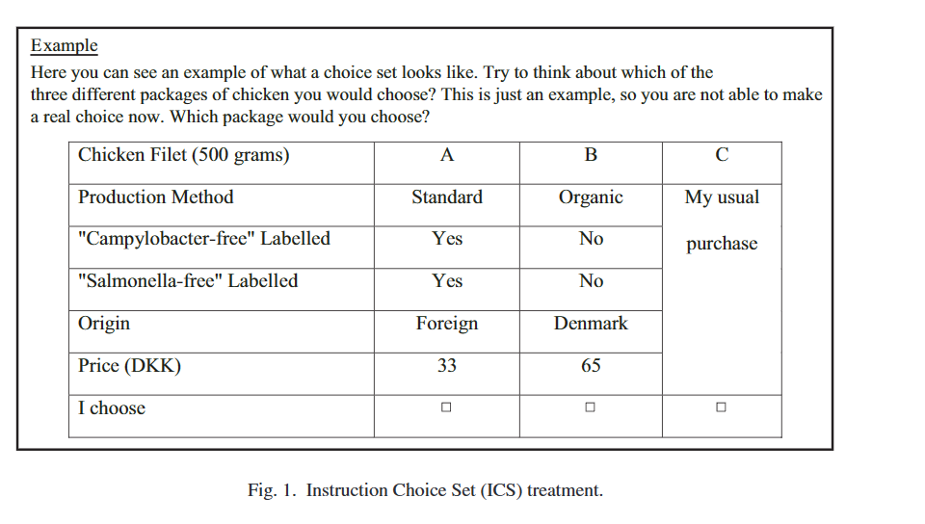
@Alex, Kilian: Instructional Choice Set
In a similar vein, Ladenburg and Olsen (2008) introduced the ICS aiming to reduce respondents’ uncertainty and prepare respondents for the actual choice tasks to come. In an ICS setting, as defined originally by Ladenburg and Olsen (2008), a choice set is displayed for respondents as an example of the subsequent actual choice sets used in the survey for preference elicitation, but without asking the respondents to actually make a choice. In other words, ICS is somewhat similar to the use of “practice rounds” which are commonly used in experimental economics.
Notes:
Table 1 | Developing the Questionnaire | SpringerLink;
It is probable that respondents might not have a well-formed preference before taking the DCE survey, thus leading to non-informative or less accurate choices at the first few choice sets. Previous studies demonstrate that a well-designed survey with precise description and instruction, and relatively simple choice sets can enhance respondents learning process. Also, an instructional/sample choice set ahead of the designed choice sets also helps (Meyerhoff and Glenk, 2015)

Slide 5
p. 4: Discrete Choice (II) – Actual Choice Sets
Please read the reviews carefully and select the review that you find most helpful.
User
User
So far so great!
TV and sound
I bought this for my fiancé so he can have a tv for himself. The set up was always a bit confusing but I got there. And since the set up I had no issues, the sounds is awesome, the picture is great, I’m so far very satisfied and impressed.
When I set up the TV the picture was great. But the sound was a little good until I went to set up and raise the bass and other once after that I went back to the volume and put it on 10 it sound real loud. I like it and its value for the money.
This review is more helpful.
This review is more helpful.
Confirm selection
Hinweise:
Review-Länge und Review-Rating werden konstant gehalten
Product brand wird mit fiktivem Brand-Name ersetzt, da potenz. Einfluss auf helpfulness (see Huang et al. 2018)
Lerneffekt (II): Erstes Choice set für Analysen exkludieren (“one should consider including one or two examples of choice sets or additional choice sets that are not intended for use in the analysis of preferences (Ladenburg and Olsen (2008))
18 choice sets before decision fatigue (Hanson et al. 2005); Zahl wird ggf. angepasst, suche noch bessere Quelle
Es muss immer eine Entscheidung zwischen den Reviews getroffen werden → sonst Fehlermeldung
Entscheidung zwischen den Reviews kann geändert werden, bis auf Confirm selection-Button geklickt wird.

Slide 6
p. 5: Discrete Choice (III) – Attention Checks
Please read the reviews carefully and select the review that you find most helpful.
User
User
So far so great!
TV and sound
I bought this for my fiancé so he can have a tv for himself. Click on the star rating above instead of selecting a review. And since the set up I had no issues, the sounds is awesome, the picture is great, I’m so far very satisfied and impressed.
When I set up the TV the picture was great. But the sound was a little good until I went to set up and raise the bass and other once after that I went back to the volume and put it on 10 it sound real loud. I like it and its value for the money.
This review is more helpful.
This review is more helpful.
Confirm selection
Hinweise:
Weitere attention Checks: „Click next without selecting a review.“; „Click on the user icon instead of selecting a review“; „Click two times on the button of the review you find more helpful“; ….
Wird ein attention check falsch beantwortet, fliegt Proband umgehend aus dem Experiment.
Attention Check-Reviews werden künstlich generiert, um keine echten Reviews zu verschwenden
2 Attention Checks innherlab Choice Sets
Position der attention checks wird innerhalb einer choice und über alle choice sets hinweg randomisiert.
Notes:
Design der Reviews ggf. an Design BestBuy anpassen, falls wir Scenario direkt auf BestBuy framen und „BestBuy“ in Reviews nicht ersetzen
TBD.
Von Steffi: falls das TBD von dir kommt Alex… Bestbuy wird aus den Reviews ja rausgenommen, die Datei habe ich euch schon vor über einem Monat geschickt als wir das noch nicht entschieden hatten

Slide 7
p. 6: Discrete Choice (IV) – Attention Checks
We're sorry, but you failed to answer an attention check question correctly. Hence, you cannot continue with the study and will not receive any payment.
Next
Notes:
+ begründung was gefailed wurde?
Next vs anderen button vs kein button?
Von Steffi: Einen Button brauchen wir, damit wir auf die Schlussseite kommen oder? Next passt für mich aber bin auch offen für andere Vorschläge. Erklärung zu liefern finde ich schwierig, dann wissen die halt was man hätte tun müssen und können das in ihre Foren posten. Kilian findet es auch besser ohne Erklärung, haben gestern kurz gesprochen.

Slide 8
p. 7: Control Variables (I)
The following questions no longer refer to the online shopping scenario. Instead, they refer to you and your personal experience. Please answer them accordingly.
Control variables (I)
Age, Gender, Education, Country of origin, Income | Keine Abfrage im Experiment → ziehen wir aus CloudConnect
Familiarity with product | What is your experience with televisions? I own a television. I plan to buy a television. I neither own nor plan to buy a television.
Familiarity with online shopping | How often do you shop online? Daily Weekly Monthly Rarely
Familiarity with online reviews | How often do you read online customer reviews before buying a product online? (Almost) every time Often Rarely Never
Notes:
Da haben wir doch von fake reviews ne überleitung oder? also sowas wie „danke, das wars mit der aufgabe, ejttz noch ein paar fragen..“
Von Steffi: die hatte ich drin, aber Kilian hat die wohl nicht so zugesagt :D hab sie aber wieder reingemacht, passt für ihn

Slide 9
p. 8: Control Variables (II) – Consumer Decision Making Styles
The following questions no longer refer to the online shopping scenario. Instead, they refer to you and your personal experience. Please answer them accordingly.
Control variables (III) – Utilitarian Shopping Styles (original items from Sprotles & Kendall 1986)
Perfectionist high-quality conscious consumer | Getting very good quality is very important to me. I make special effort to choose the very best quality products. [Six-point Likert scale]
Price conscious „value for money“ consumer | I buy as much as possible at sale prices. I look carefully to find the best value for the money. [Six-point Likert scale]
Impulsiveness – Careless consumer | I am impulsive when purchasing. Often, I make careless purchases I later wish I had not. [Six-point Likert scale]
Confused by over choice consumer | There are so many brands to choose from that often I feel confused. All the information I get on different products confuses me. [Six-point Likert scale]

Slide 10
p. 8: Control Variables (III) – Consumer Decision Making Styles
The following questions no longer refer to the online shopping scenario. Instead, they refer to you and your personal experience. Please answer them accordingly.
Control variables (III) – Hedonic Shopping Styles (original items from Sprotles & Kendall 1986)
Brand conscious, “price equals quality“ consumer | The more expensive brands are usually my choice. I prefer buying the well-known brands. [Six-point Likert scale]
Recreational, hedonistic consumer | I enjoy shopping just for the fun of it. I try to minimize my time the time I spent with (online) shopping [Six-point Likert scale]
Habitual, brand-loyal consumer | Once I find a product or brand I like, I stick with it. I change brands I buy regularly. [Six-point Likert scale]

Slide 11
p. 9: Final Page
Thank you for participating in this study!
We sincerely appreciate your help.
Your answers have been recorded and you can close the browser window or tab now.

Slide 12
Back Up (I) – Review-Preprocessing und Choice Sets
Review-Preprocessing:
BestBuy mit fiktivem Namen ersetzen
Markennamen mit fiktivem Namen ersetzen
Modellbezeichnungen (z.B. Bravia XY) mit fiktivem Namen ersetzen
Choice Sets:
Sterne-Rating konstant halten
Länge (bis zu bestimmter Abweichung) konstant halten → to be checked ansonsten für Länge kontrollieren
Position der Reviews innerhalb und außerhalb des Choice Sets randomisieren
Sonstiges:
Aus dem Set an Reviews werden jeweils randomisiert Reviews für Instructional Choice Set und erstes Choice Set
ausgewählt
Attention Check-Reviews können hingegen einmal erstellt und recycelt werden
Notes:
Erläuterung zu Types in 154604 75..87 (emerald.com)

Slide 13
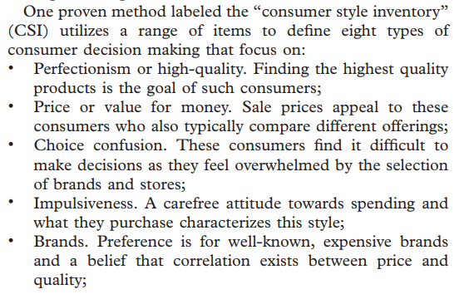
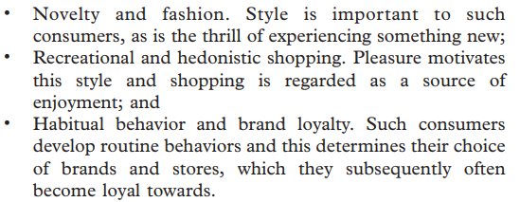
Back Up (II) – Consumer Decision Making Styles
utilitarian shopping style: shoppers are essentially task-driven with price, value and quality being their main concerns
and consumer information
hedonic shopping style: shoppers focus on the pursuit of pleasure and attach importance to “personal gratification, self-expression and brand awareness”
Übersicht zu Utilitarian und Hedonic Styles von Lysonski & Durvasula (2013).
Notes:
Erläuterung zu Types in 154604 75..87 (emerald.com)

Slide 14
Quellen
Huang, L., Tan, C. H., Ke, W., & Wei, K. K. (2018). Helpfulness of online review content: The moderating effects of temporal and social cues. Journal of the Association for Information Systems, 19(6), 3.
Lysonski, S., & Durvasula, S. (2013). Consumer decision making styles in retailing: evolution of mindsets and psychological impacts. Journal of Consumer Marketing, 30(1), 75-87.
Sprotles, G. B., & Kendall, E. L. (1986). A methodology for profiling consumers' decision‐making styles. Journal of Consumer Affairs, 20(2), 267-279.

